Slide 1
UMLC 2020 x Blockchain
GIST College, 7th Semester
School of EECS
Suwhoan Lim (임수환)

Slide 2
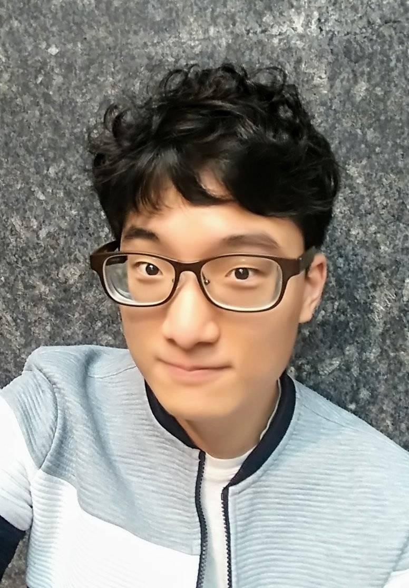
1. About Myself!
Suwhoan Lim (임수환)
1998.04.17 ~
GIST College, School of EECS, 7th Semester
Lab Intern @ INFONET Lab (INFOrmation sensing, processing, controlling and NETworking)
Under Supervision of Prof. Heung-No Lee (infonet.gist.ac.kr)

Slide 3




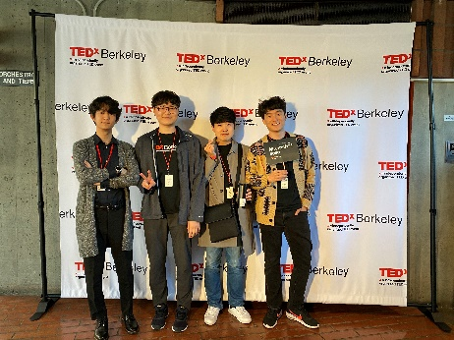
1. About Myself! – Things I Like
Reading short novels
Watching movies
Spending time with my family / friends
Current Interest:
- Blockchain Technology – Security / Scalability
- Looking forward to meet new people @ UMLC 2020!

Slide 4
2. Research Intro – Blockchain E-Voting
Problem:
Voting data can be fabricated
Solution:
Let’s store data on a blockchain
Problem 2:
Blockchain is public (Everyone can access the data)
Solution 2:
Encrypt the data before sending it to the blockchain
Shamir’s Secret Sharing Scheme.

Slide 5



2. Research Intro –
Implement Shamir’s Secret Sharing Scheme in python
Automatic interaction between a python file and Ethereum Testnet (Smart Contract)
…
Web3py Library
Smart Contract (Solidity)
Ethereum
Testnet
Python Code
…

Slide 6
Thank You

